Slide 1
Hang with Your Buddies to Resist Intersection Attacks
David Wolinsky, Ewa Syta, Bryan Ford
Yale University

Slide 2

Need for Anonymity
Meet Tuesday at 7 PM in the park for pizza and beer!
Hahaha! Got you! No fun for you!!!
Nofunistan
Notes:
Intersection attacks mitigate the usefulness of anonymous communication. Anonymous communication has many uses. Particularly in the country of Nofunistan. Nofunistan has a large, unhappy population deeply desiring to have fun, but their ruthless dictator named boring leader constantly thwarts their efforts. Despite their efforts to throw parties, boring leaders spies hide among them, arresting the organizer, and quelling any attempts at fun.

Slide 3



Need for Anonymity
Meet Tuesday at 7 PM in the park for pizza and beer!
Nofunistan
Funland
Notes:
In the far away country of Funland, exist a bunch of happy people. These people enjoy free and uninhibited access to fun and services that can be used to organize and coordinate upcoming fun events and share memories about fun events in the past via Twitter, Facebook, and Youtube. Fortunately for the people of Nofunistan, they do have access to Funland’s Internet services and attempt to use them for organizing fun within their own borders.

Slide 4
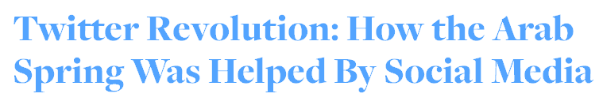
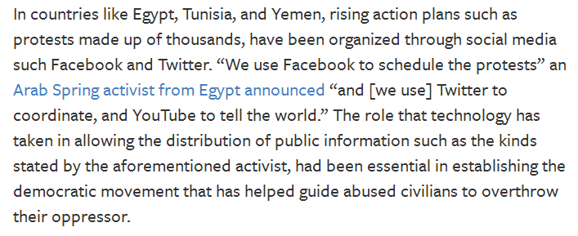
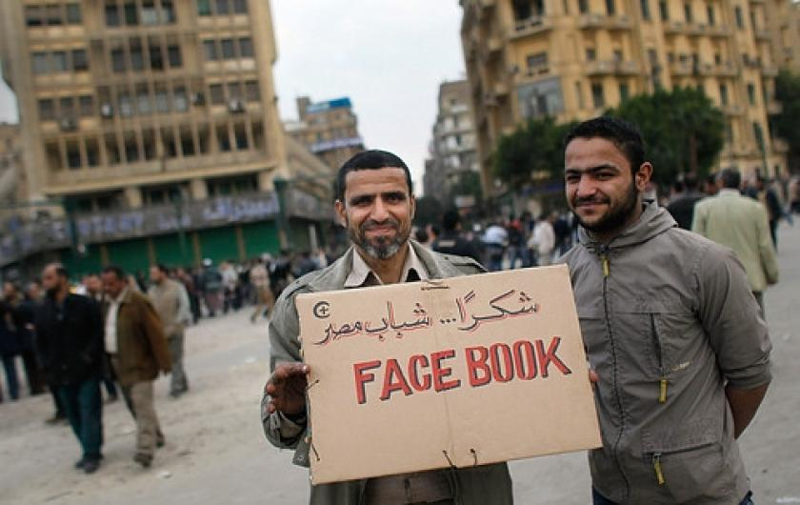
Need for Anonymity
Notes:
Much like Nofunistan, participants of the Arab Spring made use of social networking services outside their country for coordination and organization.

Slide 5
Need for Anonymity
Meet Tuesday at 7 PM in the park for pizza and beer!
Hahaha! Got you! No fun for you!!!
Nofunistan
Funland
Notes:
However, had boring leader had sufficient resources to monitor the Nofunistani network usage and the output of social networking services. His spies would easily be able to identify the source of fun event announcements.

Slide 6
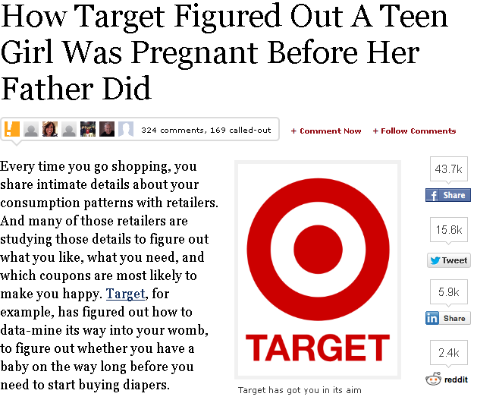
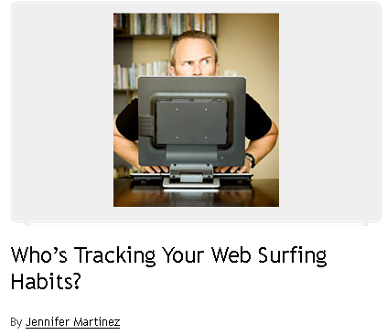
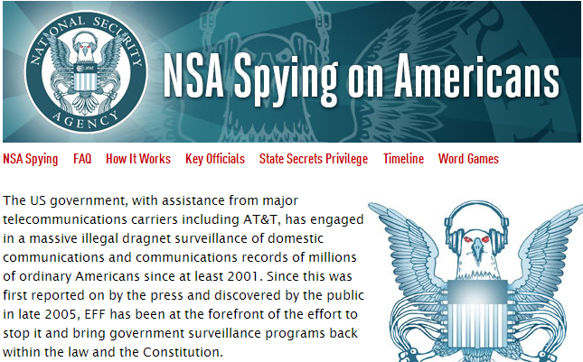
Need for Anonymity
They Know What You're Shopping For
'You're looking at the premium package, right?' Companies today are increasingly tying people's real-life identities to their online browsing habits.
Notes:
But anonymity isn’t important just for people in Nofunistan. Even people in Funland need anonymity. In Funland, advertisers and corporations have begun to actively monitor user behavior. Anonymous communication prevents that information from being linked to them.

Slide 7

Anonymity in Action
Meet Tuesday at 7 PM in the park for pizza and beer!
You win this time!
Anonymizer
Nofunistan
Funland
Notes:
To get around boring leader’s spies, the people en masse connect to the Internet using anonymous communication tools. Now when one of them posts the message about the fun event, the spies have no clue where the message came from.

Slide 8
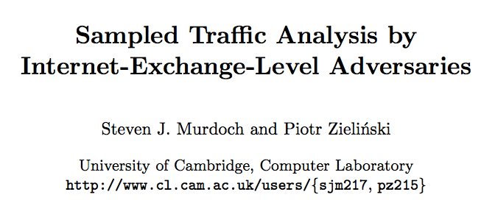
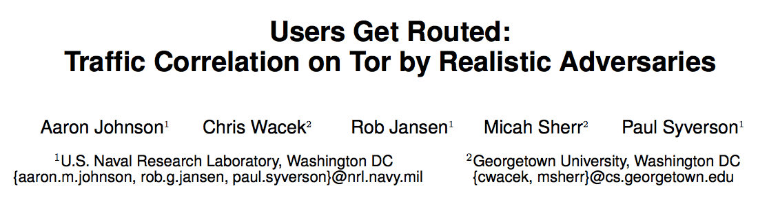
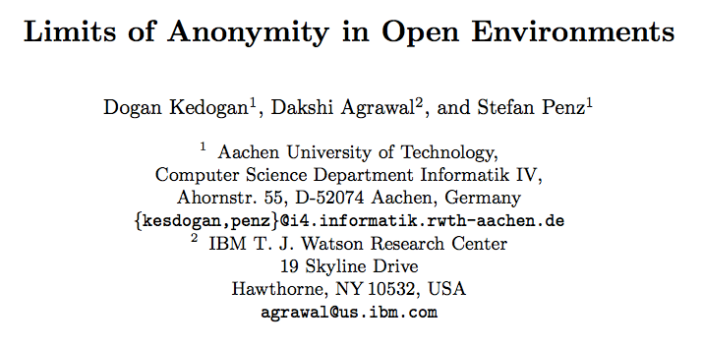
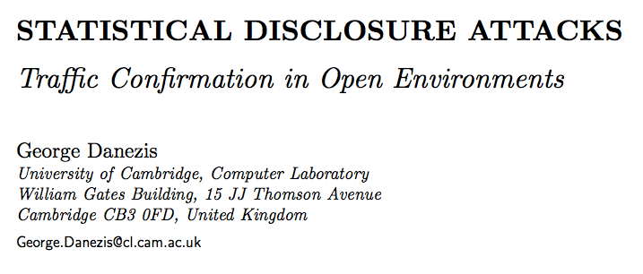
Attacks Against Anonymity
Notes:
But boring leader has a lot of time on his hands and investigates research on the topic of deanonymizing users an stumbles upon the intersection attack.

Slide 9
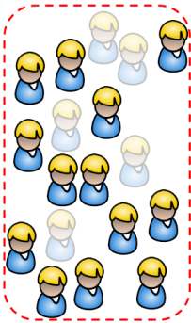
The Intersection Attack
X
X
Meet Tuesday at 7 PM in the park for pizza and beer!
X
Anonymizer
X
X
Notes:
This time, boring leader’s spies watches the online status of users, those appearing slightly transparent are offline, and the output of messages announcing fun events. When a message is posted, the spies remove suspicion from all users who were offline. Those with a big red X over them will be ignored as possible owners of the anonymous message in future exchanges despite their online state.

Slide 10
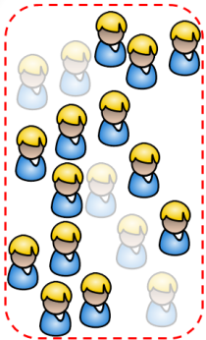
The Intersection Attack
X
X
X
Meet Tuesday at 7 PM in the park for pizza and beer!
X
X
Meet Friday at 7 PM in the park for pizza and beer!
Anonymizer
X
X
X
X
X
U
Notes:
The process continues. After each iteration, the spies have further narrowed the set of potential owners.

Slide 11
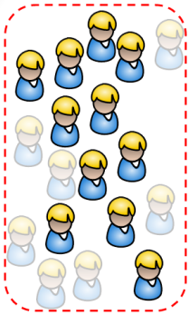
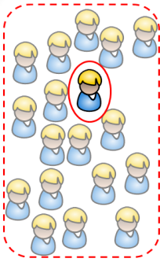
The Intersection Attack
X
X
X
X
Meet Tuesday at 7 PM in the park for pizza and beer!
X
But I got you this time!
X
Meet Friday at 7 PM in the park for pizza and beer!
X
Anonymizer
X
X
X
Meet Monday at 7 PM in the park for pizza and beer!
X
X
X
X
X
X
X
U
U
=
Notes:
After sufficiently many message postings, the spies have found that only a single user has been online for each message post. The users anonymity is lost despite him making use of an active anonymous communication system!

Slide 12
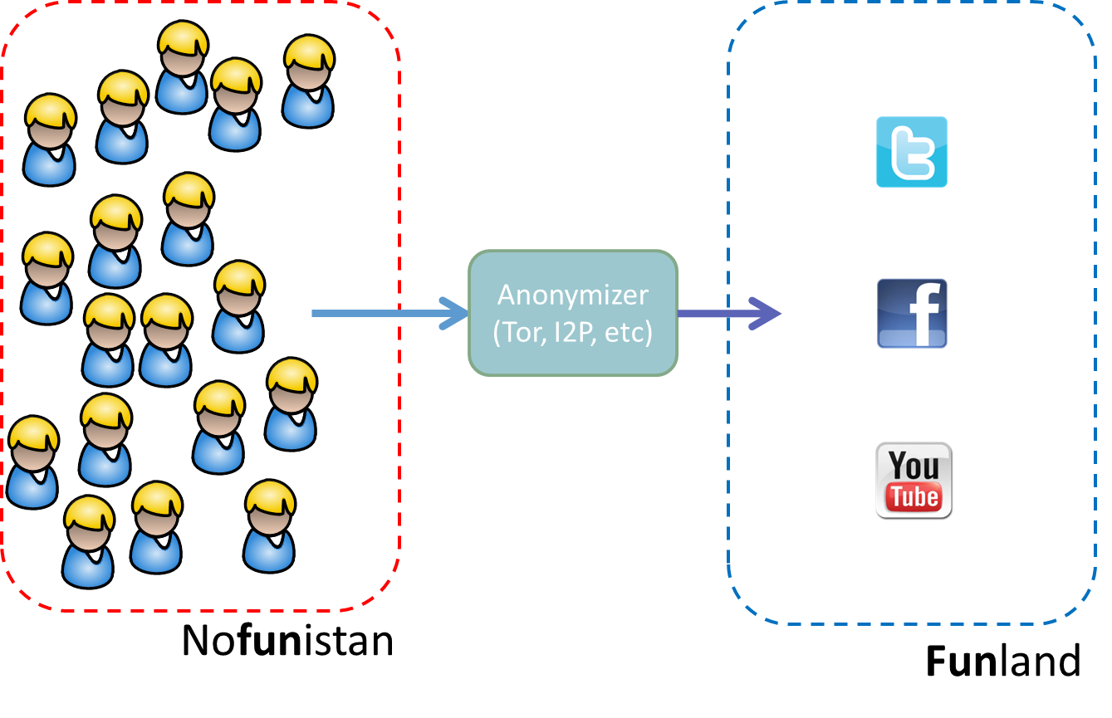

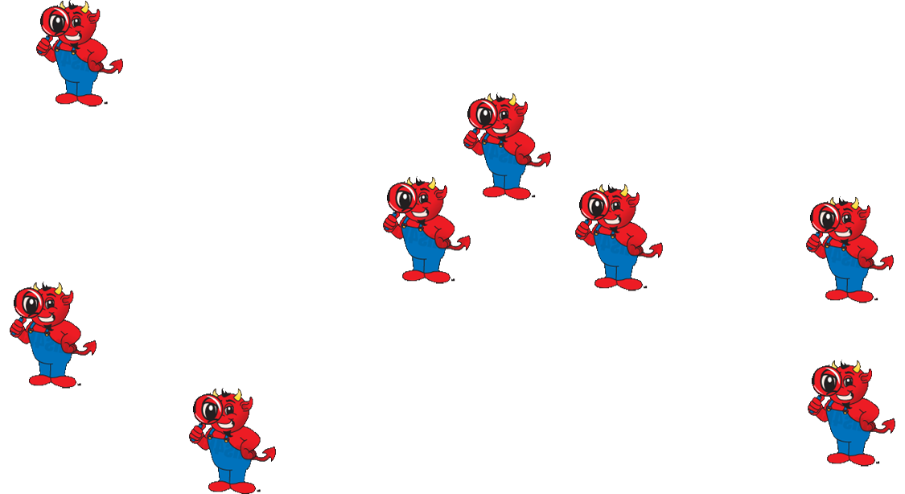
Buddies Overview
Buddies Goal: Prevent intersection attacks given a global, active adversary
Notes:
Anonymity may still suffer despite intersection attacks. We want to systematically prevent intersection attacks despite adversary model.

Slide 13
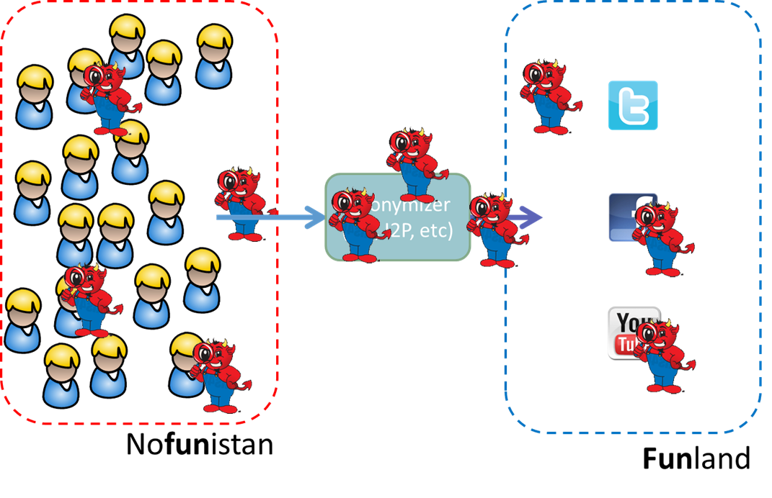
Buddies Overview
Buddies Goal: Prevent intersection attacks given a global, active adversary
Insight: Indistinguishable behavior among a k-set of users or “buddies” – a buddy set
Notes:
Intersection attacks make use of differences between users and correlates this information to linkable messages. Through our system buddies, we will build groups of users, or buddy sets, in which all members, or buddies, exhibiting identical behavior.

Slide 14
Buddies Overview
Buddies Goal: Prevent intersection attacks given a global, active adversary
Insight: Indistinguishable behavior among a k-set of users or “buddies” – a buddy set
Similar concept to k-anonymity
Our contributions
First design to resist intersection attacks in practical anonymity system
Two metrics to measure anonymity: possinymity and indinymity
Implemented in Dissent
Notes:
In this talk, I will focus primarily on the challenge of defining what it means to be a buddy.

Slide 15
Organization
Motivation
The Buddies Insight
Buddies Design
Buddies in Practice
Conclusions
Notes:
The next part of my talk engages the essence of buddies: the relationship between anonymity and user observable behavior

Slide 16
Possinymity
X
X
Meet Tuesday at 7 PM in the park for pizza and beer!
X
I’ll get you yet!
X
Anonymizer
Possinymity is the set of users who possibly own a pseudonym!
X
X
X
X
X
No message, no change in status
Message, change in status
Too few users, no message
No protection from statistical disclosure
Notes:
As one means to resist intersection attacks, possinymity provides possibilitic approach to anonymity or plausible deniability. A system employing possinymity has three potential outcomes from an anonymous communication round. If the system produces no message, then offline members remain within the possinymity anonymity set. If the system produces a message, then all offline members are removed from this set. Finally, if too few users are online, then the no message will be produced regardless of the intention of the users’ intent.

Slide 17
Limitations of Possinymity

Slide 18
Statistical Disclosure
A few moments later…
One week later…
Meet Tuesday at 7 PM in the park for pizza and beer!
Ahh… I think it’s you!
Meet Friday at 7 PM in the park for pizza and beer!
Anonymizer
Meet Monday at 7 PM in the park for pizza and beer!
No message, no change in status
Message, change in status
Too few users, no message
No protection from statistical disclosure
Notes:
But the adversary isn’t dumb. He’s read the literature and knows about statistical disclosure. He’s aware that users online presence can be correlated to messages and begins the process of watching the online state of participants and the messages output by the anonymizer. He notices that there exists a participant that appears online and shortly thereafter a message appears before the participant disconnects with the process repeating many times. Using his model, he correlates this user to the anonymous posts despite perfect possinymity.

Slide 19
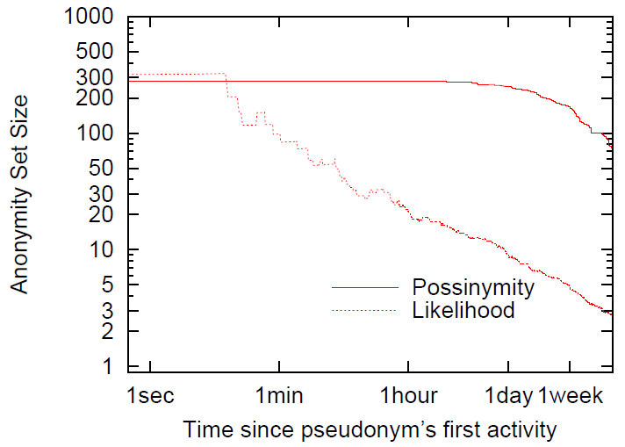
Example Statistical Disclosure Adversary
Measured possinymity
Seems anonymous
Not very anonymous
Effective anonymity
Notes:
In practice, this sort of hypothetical attack works well. As a precursor to the results shown later in this talk, this graph shows that despite measured possinymity seemingly providing strong anonymity, the effective anonyity is significantly less especially over long term use.

Slide 20
A Greater Challenge
Possinymity provides plausible deniability
May be sufficient as a legal defense
May be insufficient in Nofunistan
Conclusion: Anonymity sets alone are not sufficient for buddies
Next step: Indistinguishability!
Notes:
The reality is, possinymity doesn’t challenge the adversary. He can use statistical disclosure to correlate a users online/offlin time to post potentially making possinymity sets irrelevant. While possinymity does provide a set of members in which a user has plausible deniability, buddies want something stronger. Buddies needs indistinguishability, such that, buddies in a buddy set have identical online / offline behavior.

Slide 21
Indinymity
A few moments later…
One week later…
Meet Tuesday at 7 PM in the park for pizza and beer!
I have my doubts…
Meet Friday at 7 PM in the park for pizza and beer!
Anonymizer
Meet Monday at 7 PM in the park for pizza and beer!
One member goes offline, others follow – buddy set
All buddies in a set must be online for any to post
Notes:
Indinymity is the anonymity derived from indistinguishability. Returning to the previous example, when all members have consistent online behavior, there’s no noticeable difference. However, when a member goes offline, other members within that members buddy set also act as if they are offline. When that member returns, all members return online. If any of the members in that set go offline, then all members go offline, again returning when that members reappears. Indinymity satisfies buddies goals, strongly mitigating the effectiveness of intersection attacks and statistical disclosure.

Slide 22
Organization
Motivation
The Buddies Insight
Buddies Design
Buddies in Practice
Conclusions
Notes:
Up to this point, possinymity and indinymity have been measured and observed by the users themselves. I will now describe how buddies does this in practice.

Slide 23
Buddies Bird’s Eye View
Policy Oracle
Meet Tuesday at 7 PM in the park for pizza and beer!
Meet Friday at 7 PM in the park for pizza and beer!
Anonymizer
Meet Monday at 7 PM in the park for pizza and beer!
Knows online state of all members
Implements a global passive adversary
Filters online buddies in sets with offline users
Notes:
When users submit their ciphertext to the anonymizer, the anonymizer consults a policy oracle. The policy oracle is the heart of buddies. It monitors the state of all members acting a as global adversary in an effort to thwart such an adversary. The policy oracle applies a pre-defined policy, whether it be possinymity, indinymity, or a mix, in order to determine the set of users filtered. The anonymizer processes only the messages specified by the policy oracle and posts the results.

Slide 24
Buddies Design Summary

Slide 25

Putting It Together
Anonymizer
Registration – Attempt to be Sybil resistant
Pseudonyms
Linkable communication from a single user
Distributed independently
Notes:
Users connect to the anonymizer and register themselves in order to mitigate Sybil attacks. In turn, the anonymizer creates pseudonyms or sets of linkable messages produced from a single user. The anonymizer creates pseudonyms throughout the communication rounds and distributes them uniformly at random to the registered users. In the previous examples, we dealt with a single pseudonym owned by a single user. In practice, the anonymizer will build many pseudonyms with each user having many.

Slide 26
Putting It Together
Anonymizer
Scheduling – Anonymizer announces which pseudonym(s) will post
Notes:
Before the start of each round of communication, the anonymizer selects which pseudonyms can be posted in the upcoming round and announces this to the users.

Slide 27
Putting It Together
Anonymizer
Scheduling – Anonymizer announces which pseudonym(s) will post
Notes:
Before the start of each round of communication, the anonymizer selects which pseudonyms can be posted in the upcoming round and announces this to the users.

Slide 28
Putting It Together
Anonymizer
User ciphertexts
Pseudonyms
Users post a ciphertext for each pseudonym
Pseudonym Owner posts nothing or a real message
Others post cover traffic
Notes:
Given the list of scheduled pseudonyms, users post ciphertext. Pseudonym owners can post nothing or a real message, while others post cover traffic. The ciphertext should be indecipherable. In the table, blue represents online users who submitted ciphertexts, where red represents offline users or those who did not submit.

Slide 29
Putting It Together
Policy Oracle
Anonymizer
User ciphertexts
Pseudonyms
Anonymizer shares online state with Policy Oracle
Policy Oracle tells Anonymizer which members’ ciphertext to ignore on a per-pseudonym basis
Notes:
The anonymizer shares the online state with the policy oracle. The policy oracle analyzes the online state and selects additional ciphertext that should be withheld from being processed, effectively causing those users to appear offline. This information is returned to the anonymizer, who processes the remaining ciphertexts. Note, because each pseudonym is independent, the buddy sets nor policies for different pseudonyms need not be the same. In the table, the filtered out messages appear in purple.

Slide 30
Putting It Together
All hail Boring Bob!
Policy Oracle
Anonymizer
I like fish sticks!
User ciphertexts
Pseudonyms
Meet Monday at 7 PM in the park for pizza and beer!
Anonymizer reveals cleartext from remaining posts
Not every scheduled pseudonym posts
Owner may be offline, filtered, or have nothing to say
Notes:
Finally, the anonymizer processes the ciphertext to reveal the cleartext and posts the messages to the appropriate pseudonym. While many pseudonyms may be scheduled, not all post, the owner may have been offline, unable to post due to being filtered out via buddies, or had nothing to say.

Slide 31
Policy Oracle – Challenges
Forming buddy sets
Before we start?
When a user goes offline
After a user has been offline for a while
Organizing buddy sets
By user sign-on time
User historical online / offline time
Random
Setting buddy set size
Notes:
Questions still remain on how to define a policy. As alluded to a policy can either be in regards to indinymity or possinymity, but the process of achieving these goals can be done in varying ways. The policy oracle must know how when to form buddy sets, should this happen when a pseudonym has been created or should the policy oracle wait until users have begun to go offline? The policy oracle also needs to specify which users should be clumped together into buddy sets. Should the buddy sets be defined by sign-on or registration time or use the users online time? The random approach can do even better by preventing an adversary from gaming these two approaches. Finally the policy oracle must decide how many buddies belong in each set. Should the buddy sets start large and allowed to become smaller to a minimum buddy set size.

Slide 32
Static Buddy Sets
User Ciphertexts
Owner
Cleartext output
T0
1 | 1 | 1 | 1 | 2 | 2 | 2 | 2 | 3 | 3 | 3 | 3
Time
T1
1 | 1 | 1 | 1 | 2 | 2 | 2 | 2 | 3 | 3 | 3 | 3
T2
…
1 | 1 | 1 | 1 | 2 | 2 | 2 | 2 | 3 | 3 | 3 | 3
Ti
1 | 1 | 1 | 1 | 2 | 2 | 2 | 2 | 3 | 3 | 3 | 3
Static policies assign buddy sets before first transmission (T0)
Unable to adjust to unpredictable nature of users

Slide 33
Dynamic Buddy Sets
User Ciphertexts
Owner
Cleartext output
T0
1 | 1 | 1 | 1 | 1 | 1 | 1 | 1 | 1 | 1 | 1 | 1
T1
1 | 1 | 1 | 2 | 2 | 1 | 1 | 1 | 2 | 1 | 1 | 1
Time
1 | 1 | 1 | 2 | 2 | 1 | 1 | 1 | 2 | 1 | 1 | 2
T2
…
3 | 1 | 1 | 2 | 2 | 1 | 1 | 1 | 2 | 1 | 1 | 2
3 | 3 | 3 | 2 | 2 | 3 | 1 | 1 | 2 | 1 | 1 | 2
Ti
3 | 3 | 3 | 2 | 2 | 3 | 1 | 1 | 2 | 1 | 1 | 2
Dynamic policy places all buddies into a single set
Makes sets as client behavior changes
Able to provide better utility as an owner is more likely to be kept online

Slide 34
Organization
Motivation
The Buddies Insight
Buddies Design
Buddies in Practice
Conclusions
Notes:
As we will explore next, in practice, buddies effectiveness depends on the policy used.

Slide 35
Buddies in Practice
Anonymizer – Dissent
Scalable Group Anonymous Communication
Dissent – Corrigan-Gibbs CCS’10
Scalable Dissent – Wolinsky OSDI’12
Policy Oracle
Simulator – Python
Extension to Dissent – C++
Notes:
Before getting into the evaluation details, I will review some preliminaries. Buddies can be built using Dissent as an anonymizer. Dissent provides scalable group anonymous communication. The policy oracle has been implemented as a simulator written in python and as an extension to Dissent, which is written in C++. This talk focuses on simulated analysis of buddies.

Slide 36
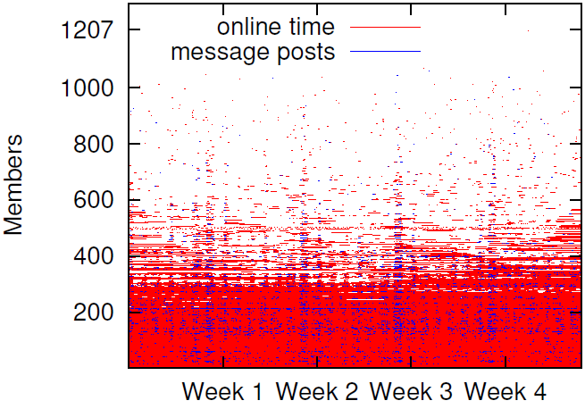
Experimental Dataset
Unreliable users
sorted by online time
Reliable Users
Dataset info:
EFnet IRC #football channel
1 Month continuous monitoring
1207 total users, 300 users online most of the time
Notes:
To evaluate buddies, we monitored the IRC channel football on Efnet. We monitored it during the 2012 football season during the month of November. Over that time, over 1200 users accessed the chat room. This graph represents these users online time, shown in red, and the time at which they posted messages, shown in blue. While a significant number of users were online briefly, over 300 users remained online for a significant amount of time.

Slide 37
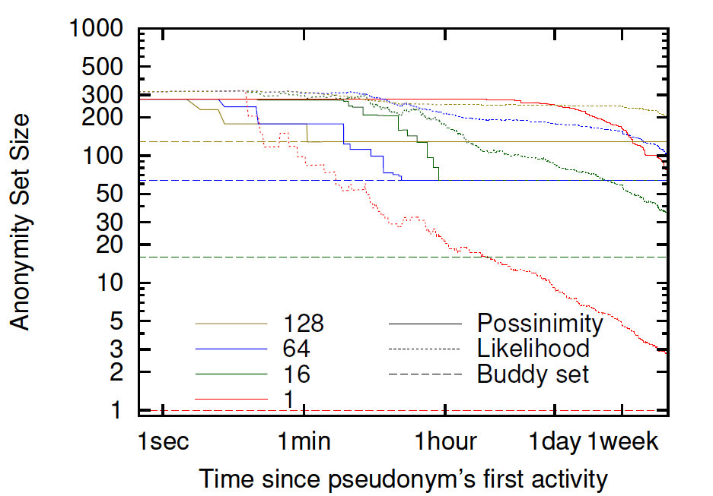
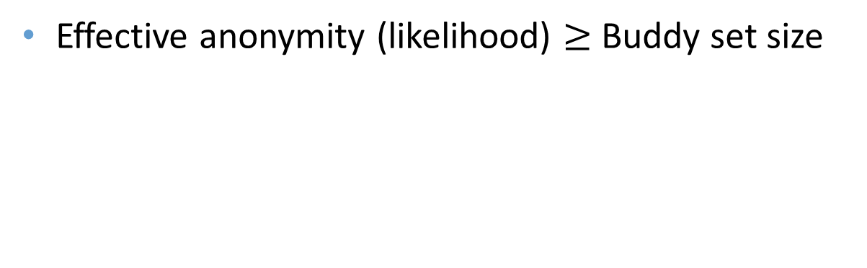
Indinymity in Practice
Maintains decent anonymity
Buddy set size
Effective anonymity (likelihood) $≥$Buddy set size
Notes:
Earlier we saw that possinymity has poor effective anonymity. This graph explores Indinymity via varying buddy set sizes over the course of a pseudonyms use. This graph shows that effective anonymity always remains greater than the buddy set size.

Slide 38
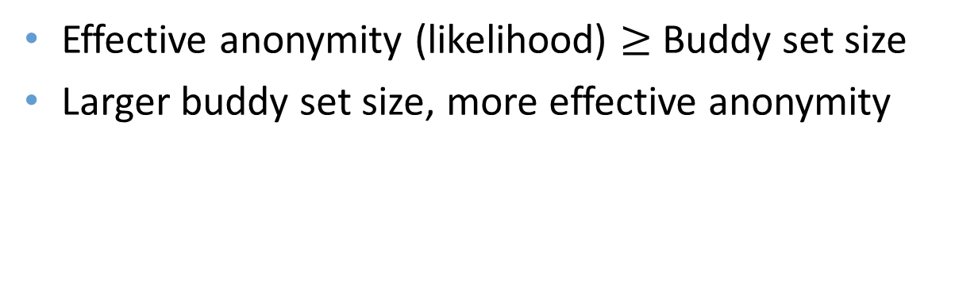
Indinymity in Practice
Great anonymity
Good anonymity
Poor anonymity
Effective anonymity (likelihood) $≥$Buddy set size
Larger buddy set size, more effective anonymity
Notes:
In terms of differing buddy set sizes, we see that smaller buddy set sizes result in less effective anonymity.

Slide 39
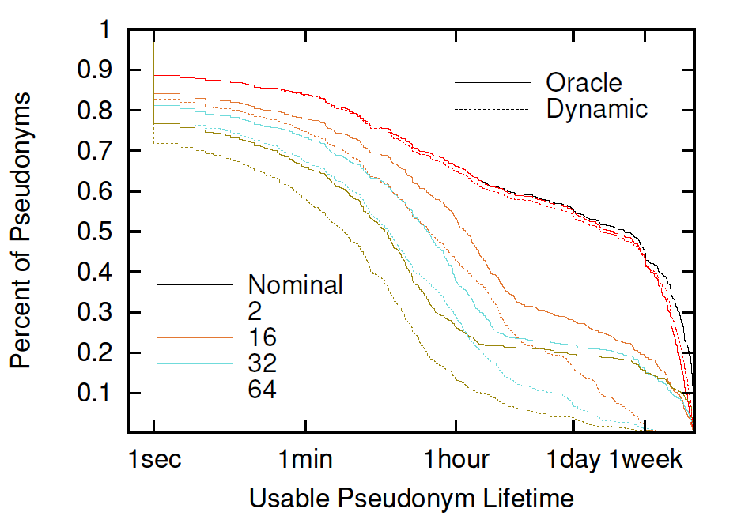
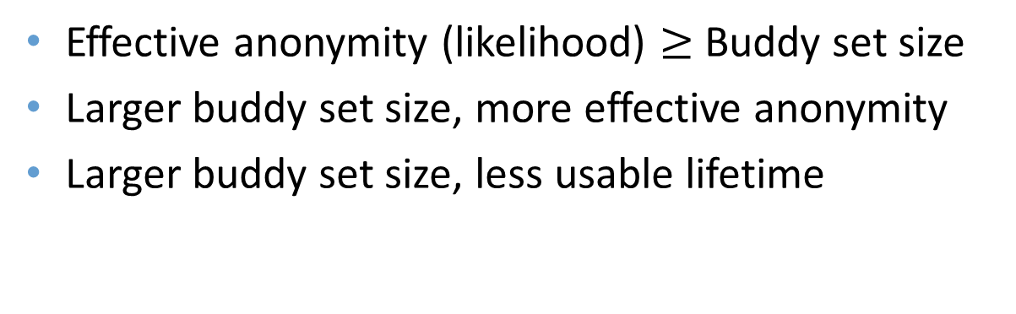
Indinymity in Practice
Nearly perfect
Decent
Not so useful
Effective anonymity (likelihood) $≥$Buddy set size
Larger buddy set size, more effective anonymity
Larger buddy set size, less usable lifetime
Notes:
However, there is a trade-off for using larger buddy set sizes, as this graph shows by measuring the usable pseudonym lifetime in terms of the pseudonyms first message to its last message. The top line represents the actual usable lifetime. We can see that buddy set sizes of 2 have nearly no effect on lifetime, but as we consider larger buddy set sizes, usability drops with very large sizes showing significant loss in usable lifetime.

Slide 40
Organization
Motivation
The Buddies Insight
Buddies Design
Buddies in Practice
Conclusions
Notes:
Now I’ll wrap up the presentation with some concluding thoughts…

Slide 41
Related Work
K-Anonymity in Mix-Nets – Hopper ’06
K-Anonymity for cover traffic in Tarzan – Freedman ‘02
K-Anonymity for cover traffic in Aqua – Le Blond ‘13
Anonym-O-Meter in Java Anonymous Proxy (JAP)
Buddies provides users control over intersection attacks through availability / anonymity trade-offs

Slide 42
Conclusions
Buddies can resist the intersection attack!
Two new metrics for measuring anonymity
Implemented in Dissent
Research into different buddy set policies necessary:
A short-term policy for quick, efficient web browsing
A long-term policy for short, infrequent posts
Optimizing usability and anonymity oppose each other
Notes:
As demonstrated, buddies can resist the intersection attack. However, buddy set policies remain immature and demand more attention. Some interesting policies include a short-term policy for quick, efficient web browsing or instant message as well as a long-term policy for short, infrequent posts, much like the situation in Nofunistan. Finally, while we have an implementation of buddies in Dissent, we are in need of an efficient approach for allocating and distributing pseudonyms.

Slide 43
Thanks, questions?
Find out more at http://dedis.cs.yale.edu/dissent
Notes:
Thanks for your attention. You can find more at the shown link. I’m now happy to take questions.

Slide 44
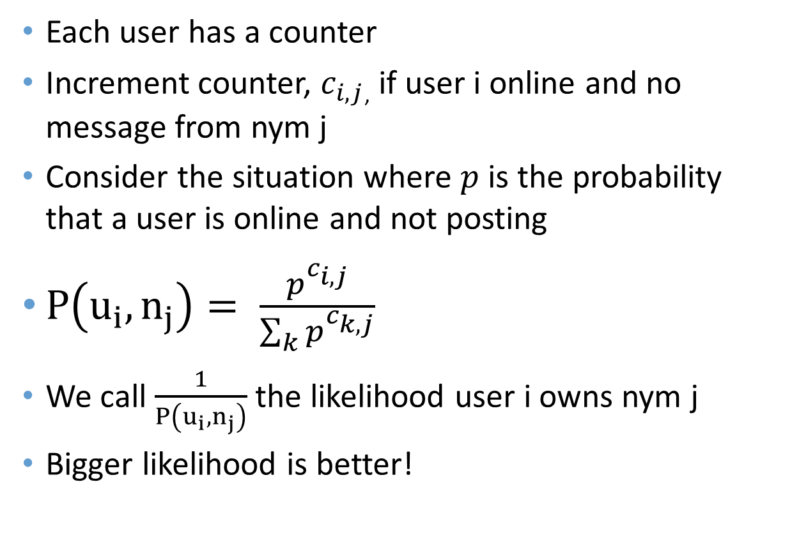
Adversary
Each user has a counter
Increment counter, $c_{i,j}$, if user i online and no message from nym j
Consider the situation where $p$ is the probability that a user is online and not posting
$P\left(u_{i}, n_{j}\right)= \frac{p^{c_{i,j}}}{\sum_{k}{p^{c_{k,j}}}}$
We call $\frac{1}{P\left(u_{i}, n_{j}\right)}$ the likelihood user i owns nym j
Bigger likelihood is better!

Slide 45
Creating Nyms
Each user provides a public key
Anonymizer re-encrypts keys and publishes
User produces re-encrypted private key
Anonymizer produces a nym (key-pair), randomly selects a re-encrypted key, encrypts the private key and distributes the key-pair
Owner can decrypt and claim, anonymously

Slide 46
The Anonymizer
Expectations
Resistant traffic analysis and timing attacks
Anytrust – protocol runs across a set of servers, a user need only trust that one server is honest without knowing which one
Not Tor – not resistant to traffic analysis / timing attacks
MIXes – Yes, if users transmit empty messages
DC-nets / Dissent – YES!

Slide 47
Anonymizer
Nofunistan
Funland

Slide 48
Anonymity in Action
Meet Tuesday at 7 PM in the park for pizza and beer!
You win this time!
Anonymizer
Nofunistan
Funland

