Slide 1
Experiences with Self-Organizing, Decentralized Grids Using the Grid Appliance
David Wolinsky and Renato Figueiredo

Slide 2
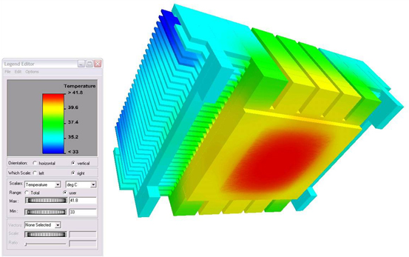
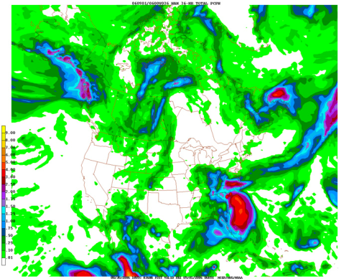

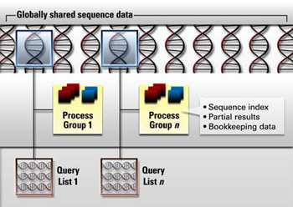
The Grid
Resource intense jobs
Simulations
Weather prediction
Biology applications
3D Rendering

Slide 3
The Grid
Resource intense jobs
Resource sharing
Consider an individual user, Alice
At times, her computer is unused
Other times, it is overloaded

Slide 4
The Grid
Resource intense jobs
Resource sharing
Consider an individual user, Alice
At times, her computer is unused
Other times, it is overloaded
Alice is not alone

Slide 5
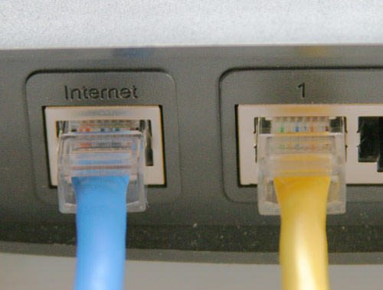
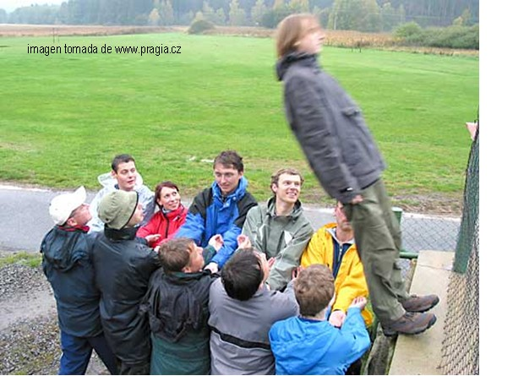
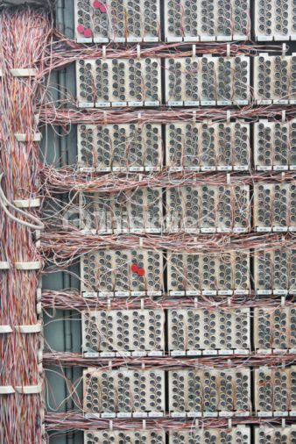
The Grid
Resource intense jobs
Resource sharing
Challenges
Connectivity
Trust
Configuration

Slide 6
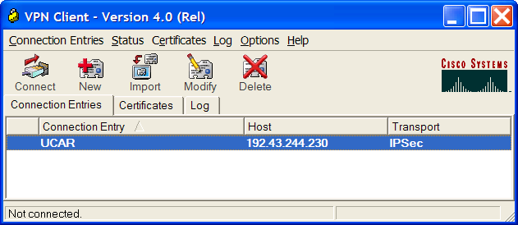
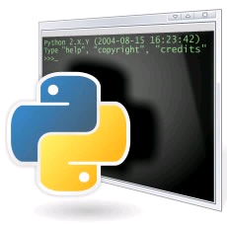

The Grid
Resource intense jobs
Resource sharing
Challenges
Solutions
VPNs address connectivity concerns and limit grid access to trusted participants
Trust can be leveraged from online social networks (groups)
Scripts automating configuration through distributed systems

Slide 7
Deployment – Archer
For academic computer architecture researchers in the world
Over 700 dedicated cores
Seamlessly add / remove resources
VM Appliance
Cloud bursting

Slide 8
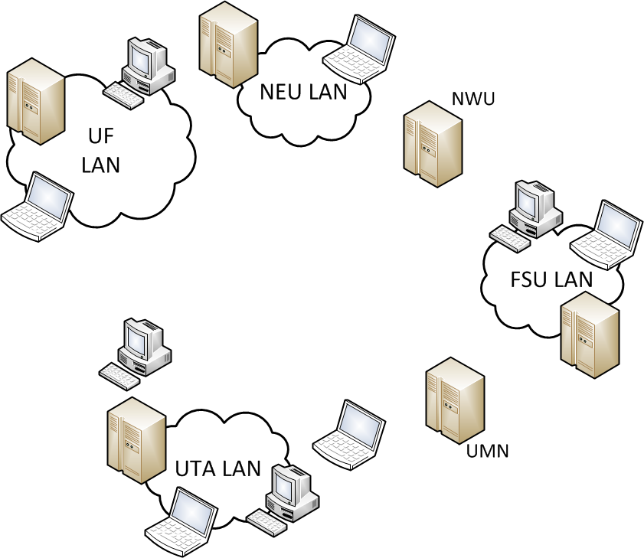
Constructing a LAN Grid

Slide 9
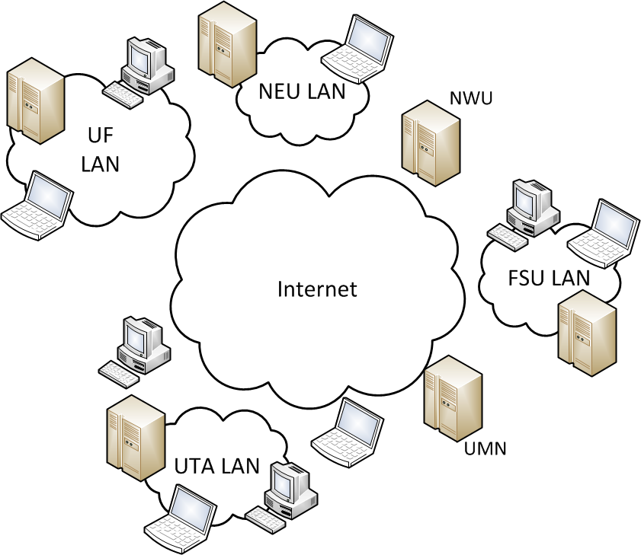
Constructing a Wide-Area Grid

Slide 10
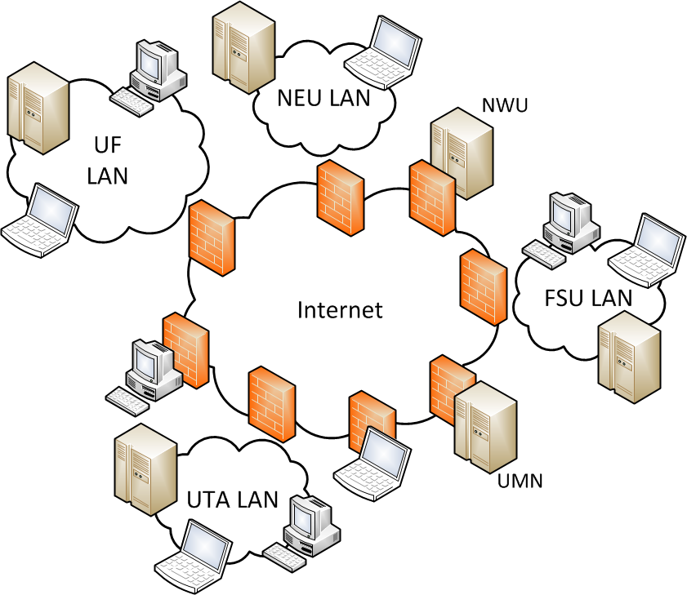
Constructing a Wide-Area Grid
X
X
X

Slide 11
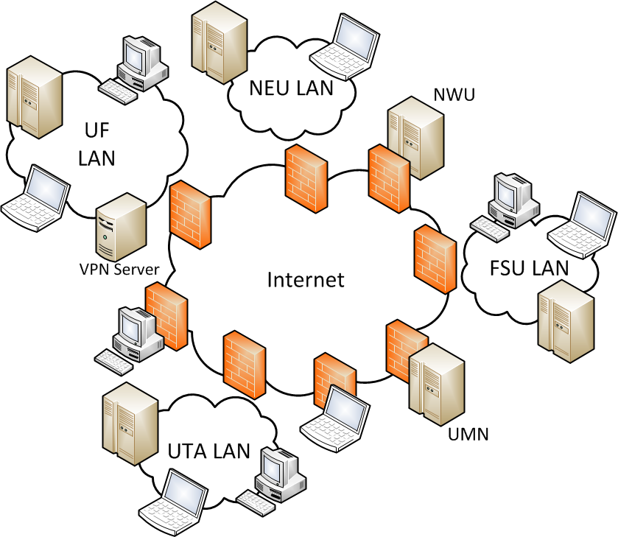
Constructing a Wide-Area Grid

Slide 12
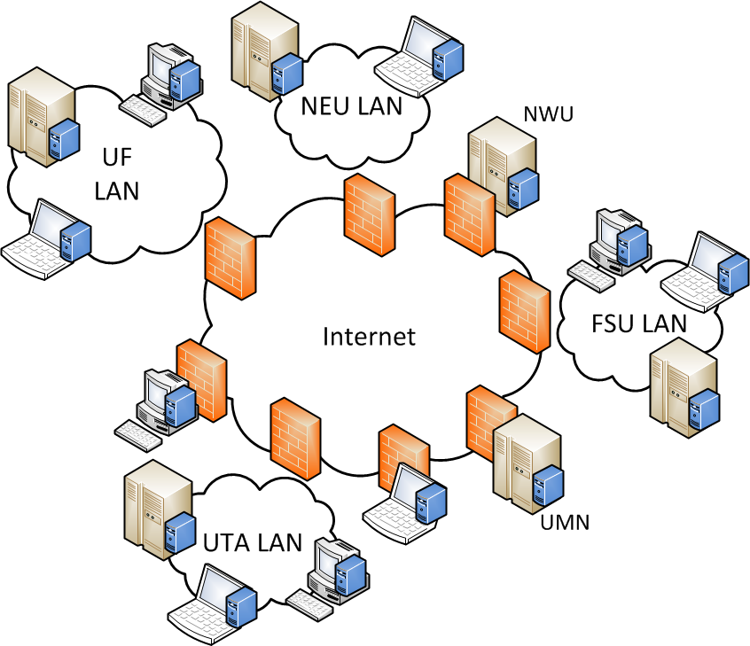
Constructing a Wide-Area Grid

Slide 13
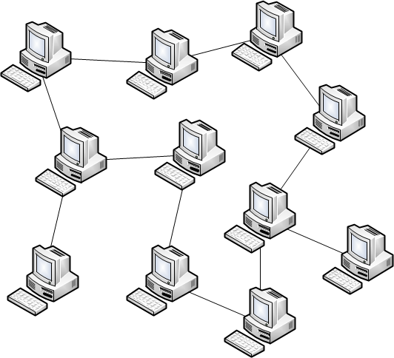
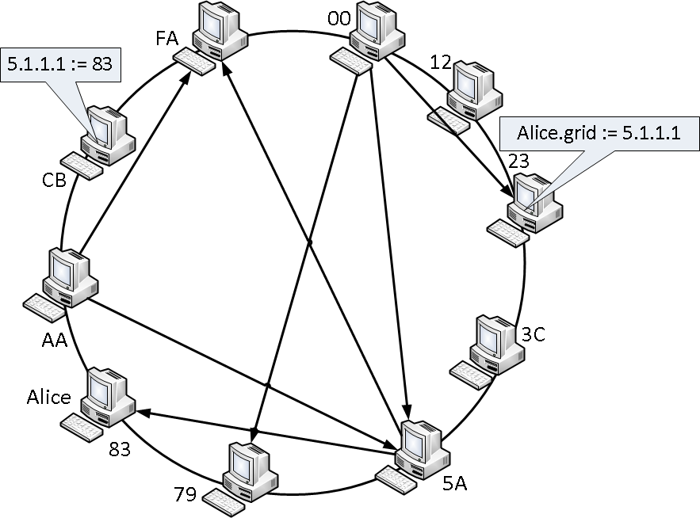
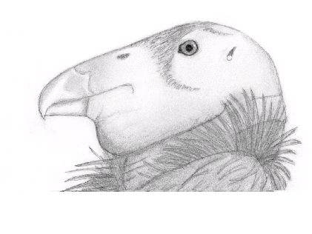
Grid Appliance Overview
Decentralized VPN
Distributed data structure for decentralized bootstrapping
Group infrastructure for organizing the VPN and the Grid
Task management (job scheduler)

Slide 14
Structured P2P Overlays
Chord, Kademlia, Pastry
Guaranteed seek time (Log N)
Distributed hash table

Slide 15
Structured P2P Overlays
Chord, Kademlia, Pastry
Guaranteed seek time (Log N)
Distributed hash table
Put – store value at hash(key)

Slide 16
Structured P2P Overlays
Chord, Kademlia, Pastry
Guaranteed seek time (Log N)
Distributed hash table
Put – store value at hash(key)
Get – Retrieve value(s) at hash(key)

Slide 17
Structured P2P Overlays
Chord, Kademlia, Pastry
Guaranteed seek time (Log N)
Distributed hash table
Put – store value at hash(key)
Get – Retrieve value(s) at hash(key)
P2P is fault tolerant

Slide 18
Structured P2P Overlays
Chord, Kademlia, Pastry
Guaranteed seek time (Log N)
Distributed hash table
Put – store value at hash(key)
Get – Retrieve value(s) at hash(key)
P2P is fault tolerant
We use Brunet
Decentralized NAT Traversal
Relaying via overlay
Platform independent (C#)
Decentralized VPN – IPOP

Slide 19
VPN Overview – Addressing

Slide 20
VPN Overview – Addressing

Slide 21
VPN Overview – Addressing

Slide 22
VPN Overview – Addressing

Slide 23
Establishing a Connection

Slide 24
Establishing a Connection

Slide 25
Establishing a Connection

Slide 26
Establishing a Connection

Slide 27
Establishing a Connection

Slide 28
Establishing a Connection

Slide 29
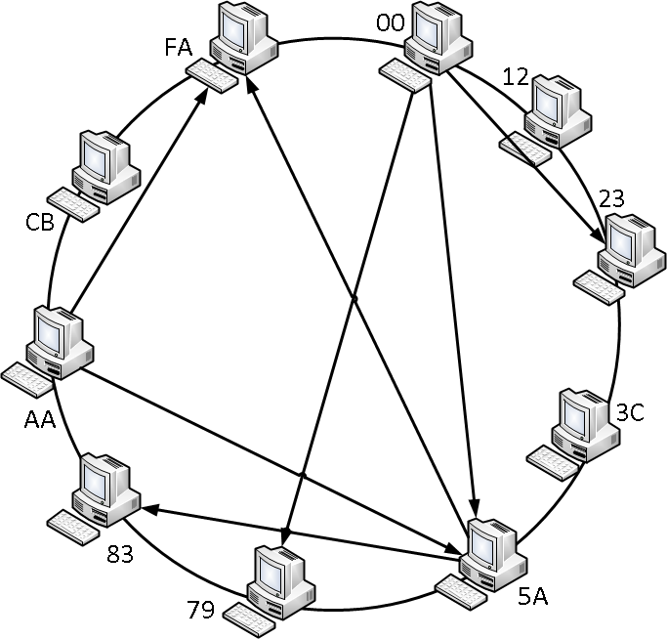
Groups
GroupVPN
Unique for an entire grid
Each grid member is a member of this group
Community
Privilege on affiliated resources
Opportunity for delegation

Slide 30
Job Scheduling
Goals
Decentralized job submission
Parallel job managers / queues
Boinc, PBS / Torque, [S/O]GE
Job manager acts as a proxy for job submitter
Besides Boinc, requires configuration to add new resource
Condor
Supports key features
Condor API adds checkpointing

Slide 31
Grid Appliance Live Action Demo!

Slide 32
Putting It All Together for the Grid

Slide 33
Putting It All Together for the Grid

Slide 34
Putting It All Together for the Grid

Slide 35
Putting It All Together for the Grid

Slide 36
Putting It All Together for the Grid

Slide 37
Putting It All Together for the Grid

Slide 38
Putting It All Together for the Grid

Slide 39
Putting It All Together for the Grid

Slide 40
Grids – Cloud Bursting
Static approach
OpenVPN
Single certificate used for all resources
Dedicated OpenVPN Server
All resources pre-configured to specific Condor scheduler
Dynamic
IPOP – GroupVPN
Dynamically generated certificates from Group WebUI
All resources dynamically find a common Condor scheduler via DHT

Slide 41
Grids – Cloud Bursting
Time to run a 5 minute job at each site
Small difference between static and dynamic (60 seconds for configuration)
Establish P2P connection for IPOP

Slide 42
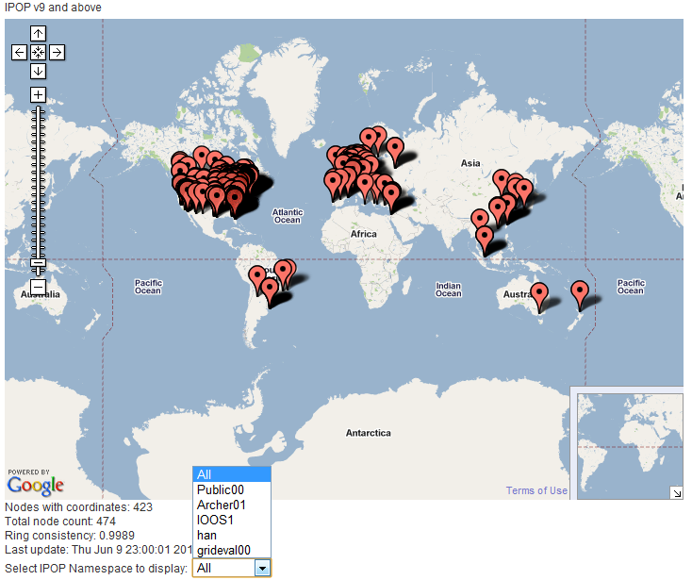
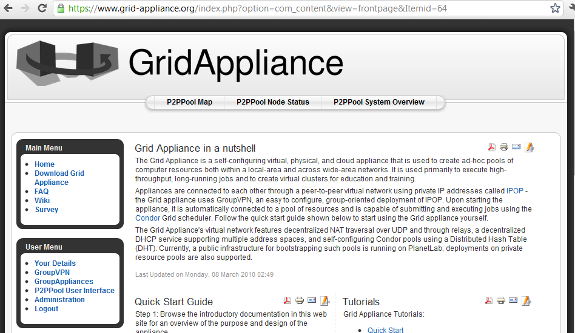
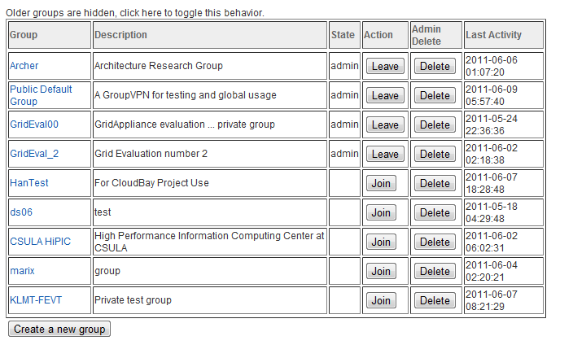
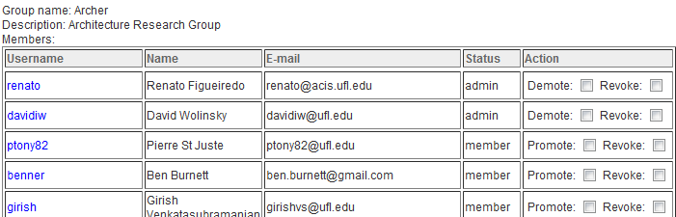
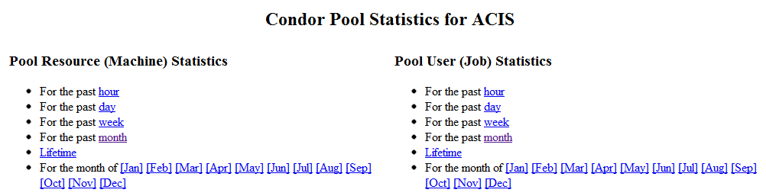
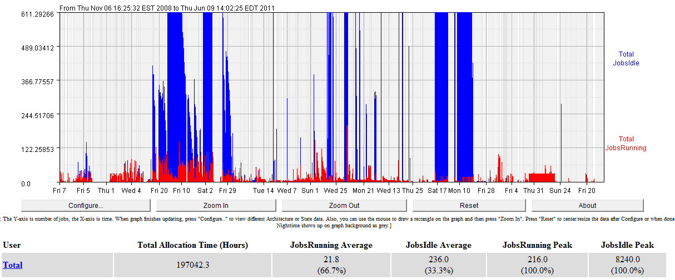
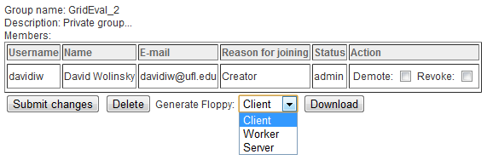
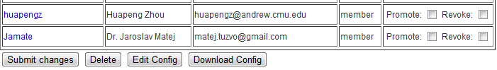
Various User Interfaces

Slide 43
Experiences / Lessons Learned
Appliances
Simplifies the deployment of complex software
Limited uptake of Linux, Appliances obviate this
Dealing with problems
Appliances + Laptops let people bring their problems to admins
SSH + VPN allows admins to access resources remotely
VM Appliance portability – not so much an issue anymore
SCSI vs SATA vs IDE => Use UUID of drive in fstab / grub
Tools (qemu-convert) can convert disk image format
Many paravirtualized drivers in Linux kernel now

Slide 44
Experiences / Lessons Learned
VMM timing
Hosts may be misconfigured, breaking some apps
VMMs can lose track of time when suspended
Use NTP – not #1 recommendation by VMM devs
Testing environments
Dedicated testing resources – fast access but $$$
Amazon EC2 – reasonable access but $$$
FutureGrid – free for academia, reasonably available
Updates
Bad – Creating your own update mechanisms
Good – Using distribution based auto-update
Challenge – Distribution releases broken packages

Slide 45
Feedback
In general, difficult to get
Most comments are complaints or questions on why things aren’t working right
Callback to home notifies of active use
Usage in classes guarantees feedback
Highlights
Usage of appliances favored and easy to understand
Our approach to grid is easy to digest
Debugging problems is challenging for users
Much more uptake after the introduction of group website

Slide 46
Future Work
Decentralized Group Configuration
Currently: Dependency on public IP
Simple Approach: Group server runs inside VN space
Advanced: Decentralized group protocol in P2P system
Condor pools without dedicated managers
Currently: Support multiple managers through flocking
In process: Condor pools on demand using P2P resource discovery

Slide 47
Acknowledgements
National Science Foundation Grants:
NMI Deployment – nanoHUB
CRI:CRD Collaborative Research: Archer
FutureGrid
Southeastern Universities Research Association
NSF Center for Autonomic Computing
My research group: ACIS P2P!

Slide 48
Fin
Thank you!
Questions
Get involved:
http://www.grid-appliance.org

Slide 49
Overlay Overview – NAT Traversal
Requires symmetry

Slide 50
Overlay Overview – NAT Traversal
Requires symmetry
NATs break symmetry

Slide 51
Overlay Overview – NAT Traversal
Requires symmetry
NATs break symmetry
NAT Traversal!

Slide 52
Overlay Overview – NAT Traversal
Requires symmetry
NATs break symmetry
NAT Traversal!
Hole punching

Slide 53
Overlay Overview – NAT Traversal
Requires symmetry
NATs break symmetry
NAT Traversal!
Hole punching
Relaying

Slide 54
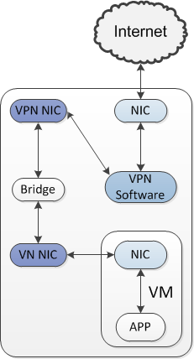
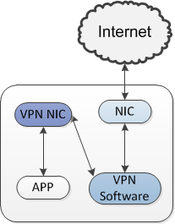
Sandboxing
Limit network connectivity to the VPN only

Slide 55
Sandboxing
Limit network connectivity to the VPN only
Limiting access in and out
Firewalls / bind applications to limit network access
Run jobs as specific users with limited privileges
Direct VM console access

Slide 56
Sandboxing
Limit network connectivity to the VPN only
Limiting (direct) host access to their own resources
Detecting access on the host
VM Appliances runs
User attempts to use … machine is too slow
User space application notifies VM Appliance
Jobs are suspended, migrated, or cancelled
User’s machine appears normal
*Not so much an issue on multicore machines

Slide 57
Conclusions
Appliances increase interaction
Decentralized VPN enable distributed systems
Distributed data structs support self-configuration
Groups provide intuitive means for managing a grid
Feedback is very difficult to come by

Slide 58
Lessons Learned / Experiences
Copy-on-write
Useful for creating modular appliances
Requires additional kernel modules
In Ubuntu, requires modified initial ram disk

