Slide 1
On the Design of Autonomic, Decentralized VPNs
David Wolinsky, Kyungyong Lee, Oscar Boykin, and Renato Figueiredo
ACIS P2P Group
University of Florida

Slide 2



Motivation
Individuals want to be connected
Online games
Exchange media
Family pictures and movies
Favorite music
Social networking
Employees want access to company resources
Access while remote
Private databases, clouds, and websites
Company printers

Slide 3
Issues
VPNs need to be more approachable!
Centralized VPNs require dedicated resources
Free VPNs rely on a third-party (trust issues)
Distributed / decentralized VPNs are complex
P2P provides promising opportunities to reduce complexity! Challenges:
No PKI secured P2P overlays
PKI relies on centralized revocation
Challenging bootstrapping small private overlays

Slide 4
GroupVPN
We have a solution!
Take an existing P2P VN (IPOP) and add:
The ability to bootstrap into private overlays
P2P and VN security (Secure P2P VPN)
Decentralized revocation techniques
Enable seamless configuration and management of the VPN
We call it GroupVPN!
Concepts and a platform for decentralized collaborative environments

Slide 5
Outline
Issues and Motivation
IPOP Overview – Motivating the GroupVPN
Bootstrapping an Isolated Overlay
Securing an Overlay
Decentralized Revocation
The GroupVPN
Conclusion

Slide 6
Outline
Issues and Motivation
IPOP Overview – Motivating the GroupVPN
Bootstrapping an Isolated Overlay
Securing an Overlay
Decentralized Revocation
The GroupVPN
Conclusion

Slide 7
IPOP Overview
A VN framework
Supports peer discovery (address resolution) through a DHT and social
networks (SocialVPN)
Written in C#, portable without recompilation

Slide 8
IPOP’s P2P Usage

Slide 9
IPOP’s P2P Usage
All nodes join a DHT overlay
Decentralized NAT traversal
Hole punching
Relaying across overlay

Slide 10
IPOP’s P2P Usage
All nodes join a DHT P2P
Decentralized NAT traversal
Hole punching
Relaying across overlay
IP Mapping => DHT[IP] = P2P

Slide 11
IPOP’s P2P Usage
All nodes join a DHT P2P
Decentralized NAT traversal
Hole punching
Relaying across overlay
IP Mapping => DHT[IP] = P2P
Connecting two peers:
Resolve IP to a P2P Address

Slide 12
IPOP’s P2P Usage
All nodes join a DHT P2P
Decentralized NAT traversal
Hole punching
Relaying across overlay
IP Mapping => DHT[IP] = P2P
Connecting two peers:
Resolve IP to a P2P Address

Slide 13
IPOP’s P2P Usage
All nodes join a DHT P2P
Decentralized NAT traversal
Hole punching
Relaying across overlay
IP Mapping => DHT[IP] = P2P
Connecting two peers:
Resolve IP to a P2P Address
Form direct connection between the two parties

Slide 14
IPOP’s P2P Usage
All nodes join a DHT P2P
Decentralized NAT traversal
Hole punching
Relaying across overlay
IP Mapping => DHT[IP] = P2P
Connecting two peers:
Resolve IP to a P2P Address
Form direct connection between the two parties

Slide 15
Remaining Challenges
Difficulty supporting ad-hoc networks
Undesirable to create bootstrap node and distribute information
Alternatively, use a public / shared overlay for all VNs
DHT is left insecure
Poorly performing / connected peers reduce effectiveness of routing via the overlay
Lacks security
P2P security would protect the DHT
Link (or end to end) security would protect the VN => VPN
How to perform decentralized revocation?
Requires intimate knowledge of IPOP to bootstrap a new P2P VN

Slide 16
Outline
Issues and Motivation
IPOP Overview – Motivating the GroupVPN
Bootstrapping an Isolated Overlay
Securing an Overlay
Decentralized Revocation
The GroupVPN
Conclusion

Slide 17
Bootstrapping Overlays
Challenges:
Dedicated bootstrap node or set of nodes
Distribute IP addresses out of band
Too much work for small or ad-hoc overlays
Our solution:
Bootstrap using existing overlays
Current support: public IPOP overlay and XMPP

Slide 18
Abstraction
EdgeListeners handle creating outgoing links and handling incoming links
Edges store state for links
Connections store overlay information for links and represent
Connection Managers create links, verify bidirectional connectivity, and add to routing
Node constructs the environment and provides basic routing primitives

Slide 19
Overheads of Multiplexing
UDP NAT Traversal:
UDP EdgeListener learns public:private IP:Port mapping from public IPOP overlay
Reuse same socket (IP:Port) / EdgeListener in the private overlay
Multiplex a single UDP EdgeListener via ``Pathing’’
Otherwise Tunnel packets through the public IPOP overlay
 | Latency (ms) | Bandwidth (mbps)
Native | .303 | 225.27
With Pathing | .308 | 224.36

Slide 20
Outline
Issues and Motivation
IPOP Overview – Motivating the GroupVPN
Bootstrapping an Isolated Overlay
Securing an Overlay
Decentralized Revocation
The GroupVPN
Conclusion

Slide 21
Securing an Overlay
Requirements
P2P links must be secured for DHT
VPN links may optionally be secured (for higher level of security)
Must support unreliable senders (UDP / Overlay)
Certificates must be mobile / not bound to IP Address
Questions:
Best approach to make transparent
Overheads / feasibility

Slide 22
Making Security Transparent
Filter model – can be placed anywhere in sending / receiving stack
DTLS supports unreliable transmissions
Bind certificate to overlay address

Slide 23
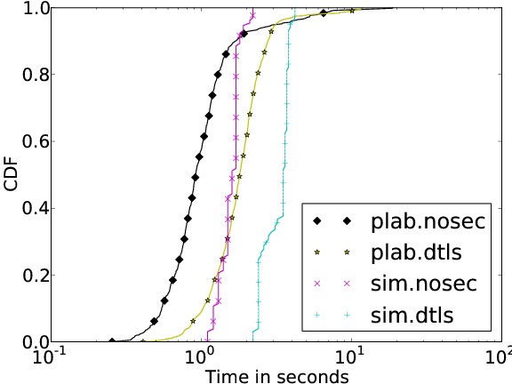
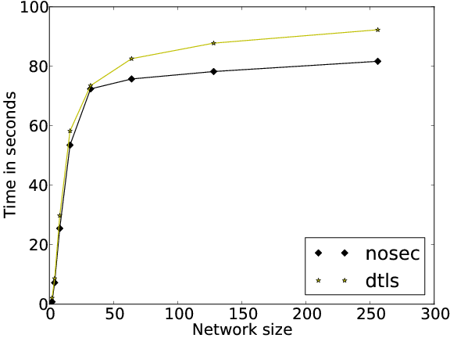
Overheads of Security
Time for a single node to join an overlay
Small (nearly negligible difference between secure and insecure bootstrapping times
Time for bootstrap an overlay (simultaneous joins)
Similar results for a single node to join the overlay

Slide 24
Outline
Issues and Motivation
IPOP Overview – Motivating the GroupVPN
Bootstrapping an Isolated Overlay
Securing an Overlay
Decentralized Revocation
The GroupVPN
Conclusion

Slide 25
Revocation – Traditional Approaches
Centralized revocation list
Revoked certificates are added to a signed revocation list
Typically hosted at a URL
Online Certificate Status Protocol (OCSP)
Determine the status of a single certificate
Typically hosted as a web service
Centralized solutions, not ideal for P2P

Slide 26
Decentralized Revocation
OCSP via the DHT
Revoked certificates are marked in the DHT as being revoked
Valid certificates
Have no entry in the DHT
Time limited entry stored in the DHT (more secure)
The former approach can be hampered by collusion attacks on the DHT, the latter may introduce unattractive overheads
Immediate revocation via overlay broadcast

Slide 27
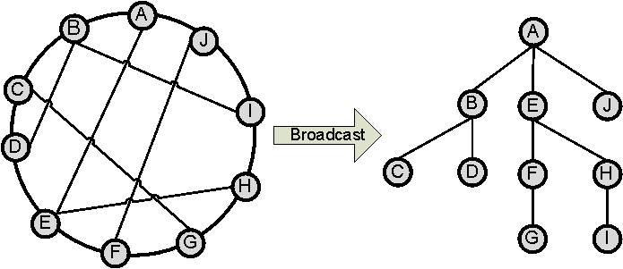
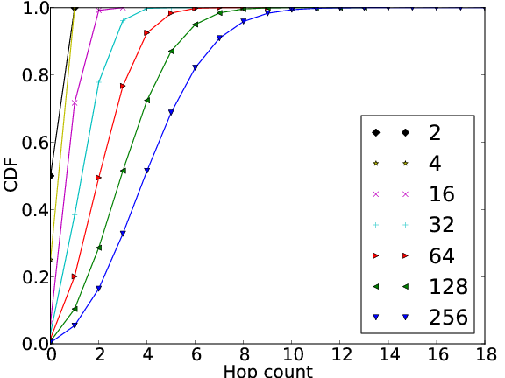
Broadcast Revocation
Efficient broadcast method immediately revokes invalid certificates in O(log²N)
Process:
Broadcasting node sends to neighbor nodes in a range
Each receiving node processes the revocation and sends in their subrange
Repeat until no nodes in subrange
Efficient – Almost all receive in less than O(log N)

Slide 28
Outline
Issues and Motivation
IPOP Overview – Motivating the GroupVPN
Bootstrapping an Isolated Overlay
Securing an Overlay
Decentralized Revocation
The GroupVPN
Conclusion

Slide 29
GroupVPN – Background
Bring all the pieces together
Users still need to configure the system
No interface for certificate signing / revocation
Solution: GroupVPN Web Interface
Publicly available at www.grid-appliance.org
Also, redistributable as a virtual machine image
Organize VPNs as social networking groups
Automated signing of certificates
Initiate certificate revocation

Slide 30
Interacting with GroupVPN
Group Interface
Create / join groups
Creating a group (Admin)
Specifying VPN attributes
IP Address range
Security parameters
User agreement
Accept / reject / revoke user access
Group members
Download VPN configuration data
VPN config data contains a private, unique identifier
During first run of a VPN, this ID is sent to the web interface to obtain a X509 signed certificate

Slide 33
GroupVPN in Action

Slide 34
GroupVPN in Action

Slide 35
GroupVPN in Action

Slide 36
GroupVPN in Action

Slide 37
GroupVPN in Action

Slide 38
GroupVPN Versus IPOP

Slide 39
Outline
Issues and Motivation
IPOP Overview – Motivating the GroupVPN
Bootstrapping an Isolated Overlay
Securing an Overlay
Decentralized Revocation
The GroupVPN
Conclusion

Slide 40
Conclusion
Multiplexing sockets enable seamless NAT traversal from a public overlay to a private overlay with low overheads
Security has nearly negligible overheads for bootstrapping overlays
Overlays can be used to provide decentralized revocation
GroupVPN like systems qualitatively reduce the overheads for deploying and managing VPNs

Slide 41
Thank you!
Questions?
(More at www.grid-appliance.org)

