Slide 1
Addressing the P2P Bootstrap Problem for Small Overlay Networks
David Wolinsky, Pierre St. Juste,
P. Oscar Boykin, and Renato Figueiredo
ACIS P2P Group
University of Florida

Slide 2

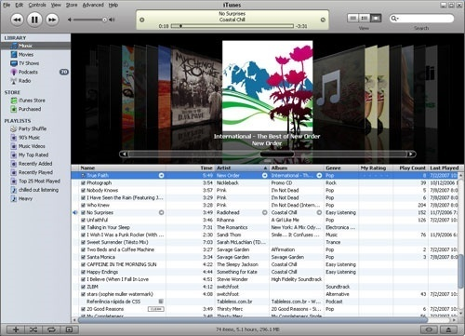

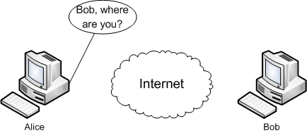
Motivation
Users want to be connected
  Online games
  Exchange media
    Family pictures and movies
    Favorite music
  Social networking
How can they get connected?

Slide 3

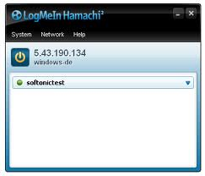

Issues
Centralized systems are not user centric
  Invasive, record / monitor you
  Limited flexibility, expandability
  Have costs associated with it
Decentralized / P2P solutions are difficult
  Bootstrapping requires a dedicated community with many users or dedicated bootstrap servers
  Has to support NAT traversal
  Must be able to identify users and communicate with them

Slide 4
Contributions
Explore bootstrapping issues in transparent, decentralized P2P systems
Investigate the use of publicly available overlays as bootstrap systems
Present our techniques in creating a small overlay using XMPP and Brunet
  XMPP / Jabber – Popular chat protocol
  Brunet – open source (structured) overlay software

Slide 5
Outline
Introduction
Overlays Bootstrapping from Overlays
Using Existing Overlays
Implementation through Recursion
Implementation through XMPP
Conclusions

Slide 6
Outline
Introduction
Overlays Bootstrapping from Overlays
Using Existing Overlays
Implementation through Recursion
Implementation through XMPP
Conclusions

Slide 7
Considerations
Transparent decentralized NAT traversal is hard
  Who provides the STUN / TURN server?
  How do users configure their software to point to that server?
How are users supposed to find each other?
  Exchange IP addresses with each other?
  Run their computers on a LAN – using multicast / broadcast software?

Slide 8
Bootstrapping

Slide 9
Bootstrapping
Reflection – Peers need global IDs so that they can communicate with each other

Slide 10
Bootstrapping
Reflection – Peers need global IDs so that they can communicate with each other

Slide 11
Bootstrapping
Reflection – Peers need global IDs so that they can communicate with each other

Slide 12
Bootstrapping
Reflection – Peers need global IDs so that they can communicate with each other
Rendezvous – The ability to identify peers with a common interest

Slide 13
Bootstrapping
Reflection – Peers need global IDs so that they can communicate with each other
Rendezvous – The ability to identify peers with a common interest

Slide 14
Bootstrapping
Reflection – Peers need global IDs so that they can communicate with each other
Rendezvous – The ability to identify peers with a common interest

Slide 15
Bootstrapping
Reflection – Peers need global IDs so that they can communicate with each other
Rendezvous – The ability to identify peers with a common interest
Relaying – Communication through the overlay to instigate NAT traversal or for when NAT traversal fails

Slide 16
Bootstrapping
Reflection – Peers need global IDs so that they can communicate with each other
Rendezvous – The ability to identify peers with a common interest
Relaying – Communication through the overlay to instigate NAT traversal or for when NAT traversal fails

Slide 17
Bootstrapping
Reflection – Peers need global IDs so that they can communicate with each other
Rendezvous – The ability to identify peers with a common interest
Relaying – Communication through the overlay to instigate NAT traversal or for when NAT traversal fails

Slide 18
Bootstrapping
Reflection – Peers need global IDs so that they can communicate with each other
Rendezvous – The ability to identify peers with a common interest
Relaying – Communication through the overlay to instigate NAT traversal or for when NAT traversal fails

Slide 19
Bootstrapping
Reflection – Peers need global IDs so that they can communicate with each other
Rendezvous – The ability to identify peers with a common interest
Relaying – Communication through the overlay to instigate NAT traversal or for when NAT traversal fails

Slide 20
Bootstrapping
Reflection – Peers need global IDs so that they can communicate with each other
Rendezvous – The ability to identify peers with a common interest
Relaying – Communication through the overlay to instigate NAT traversal or for when NAT traversal fails

Slide 21
Outline
Introduction
Overlays Bootstrapping from Overlays
Using Existing Overlays
Implementation through Recursion
Implementation through XMPP
Conclusions

Slide 22
Existing Overlays
Overlay | The Good | The Bad
BitTorrent | Very popular! | Very centralized! Limited NAT traversal
Gnutella | Completely Decentralized | Can be difficult to find rare values, no NAT traversal
Skype | Completely Decentralized with rendezvous and relaying, limited NAT traversal | Closed source, no external NAT traversal support, must use Skype transports
XMPP | Federated (Centralized / Decentralized) | Only some servers provide NAT traversal
Kademlia | Completely decentralized and very efficient rendezvous | No NAT traversal or relaying support
Brunet | Completely decentralized, supports all requirements | Academic, limited adoption

Slide 23
Outline
Introduction
Overlays Bootstrapping from Overlays
Using Existing Overlays
Implementation through Recursion
Implementation through XMPP
Conclusions

Slide 24
Brunet – Overview
Brunet provides
  Generic overlay library
  Abstracted transports library
  NAT traversal via STUN and TURN
  Structured overlay with DHT
IPOP / SocialVPN builds upon Brunet to create IP overlays
Developers can use IPOP or tap directly into Brunet
Publicly available PlanetLab overlay

Slide 25
Abstraction
EdgeListeners handle creating outgoing links and handling incoming links
Edges store state for links
Connections store overlay information for links and represent
Connection Managers create links, verify bidirectional connectivity, and add to routing
Node constructs the environment and provides basic routing primitives

Slide 26
EdgeListener / Edges
Generic transports library
Examples:
  UDP – good for NAT traversal
  TCP – works when firewalls block UDP
  Relay – route through overlay node – useful when a direct link is not available (firewall / NAT)
  Xmpp – route through XMPP server – useful for bootstrapping as well as relaying
  Subring – route through another Brunet overlay – useful for bootstrapping as well as relaying
  Pathing – Allows multiple overlays to use the same EdgeListener
Primitives
  EdgeListener::CreateEdgeTo(Address) – create a link to a remote address
  EdgeListener::Subscribe(Listener) – Listener receives packets and incoming edges
  Edge::Send(Data)

Slide 27
Initiating Private Communication

Slide 28
Initiating Private Communication

Slide 29
Initiating Private Communication

Slide 30
Initiating Private Communication

Slide 31
Initiating Private Communication

Slide 32
Initiating Private Communication

Slide 33
Outline
Introduction
Overlays Bootstrapping from Overlays
Using Existing Overlays
Implementation through Recursion
Implementation through XMPP
Conclusions

Slide 34
Introducing the Federation
XMPP is a federation
  Over 70 distinct and active service providers
  Including GoogleTalk, Jabber.org, and Live Journal
  Can establish friendships across providers – Users from GoogleTalk can chat with Jabber.org users
Overlay bootstrapping features:
  Each peer has a unique identifier in the form of name@service_provider/unique_string
  Supports sending binary messages called IQ
  Some servers support “Jingle” an XMPP service to discover STUN and TURN servers

Slide 35
Bootstrapping through XMPP

Slide 36
Bootstrapping through XMPP

Slide 37
Bootstrapping through XMPP

Slide 38
Bootstrapping through XMPP

Slide 39
Bootstrapping through XMPP

Slide 40
Bootstrapping through XMPP

Slide 41
Outline
Introduction
Overlays Bootstrapping from Overlays
Using Existing Overlays
Implementation through Recursion
Implementation through XMPP
Conclusions

Slide 42
How Well Does it Work?
In Seconds | Reflection | Rendezvous | Relaying | Connected
XMPP | .035 | .110 | .243 | 20.3
Brunet | 3.05 | .330 | .533 | 23.22
Time to bootstrap 5 peers behind 5 different port restricted cone NATs
Tests were repeated 5 times – averages shown
Reflection is time for the private peer to become aware – Brunet slowed due to booting public node first
Rendezvous
  XMPP presence notification from the server
  Brunet measures a DHT look up
Relaying
  XMPP – time to relay a packet through the server
  Brunet – time to relay a packet through the overlay
Connected – time until all nodes are part of a new overlay
Recent work has discovered a bug that makes connectivity much faster (on the order of a few seconds)

Slide 43
Experiences
Supporting XMPP is not the same as being in the Federation – Facebook supports XMPP clients but does not support IQ (data messages)
GoogleTalk blocks communication from PlanetLab
Cross-domain XMPP initiation appears delayed – up to 30 seconds between jabber.rootbash.com and GoogleTalk

Slide 44
Our Use (1) – SocialVPN
SocialVPN uses XMPP friendships to establish VPN links
Originally, XMPP was only used to exchange certificate and then links were formed through our public Brunet overlay
Now if our public overlay is down – Peers can direct links via XMPP
What happens if XMPP is down – Peers can form direct links via the overlay
SocialVPN is no longer dependent on our overlay!

Slide 45
Choosing Overlays
Goal achieved– Completely transparent solution
  Reflection for identity
  Rendezvous to find peers
  Relaying to establish direct links
Limited our choices to XMPP and Brunet
Issue with XMPP – Users must be friends in order to have successful rendezvous
Future work – Use Kademlia for rendezvous to automatically create XMPP friends and use XMPP for relaying and reflection

Slide 46
Thank you!
Questions?
More at www.ipop-project.org

Slide 47
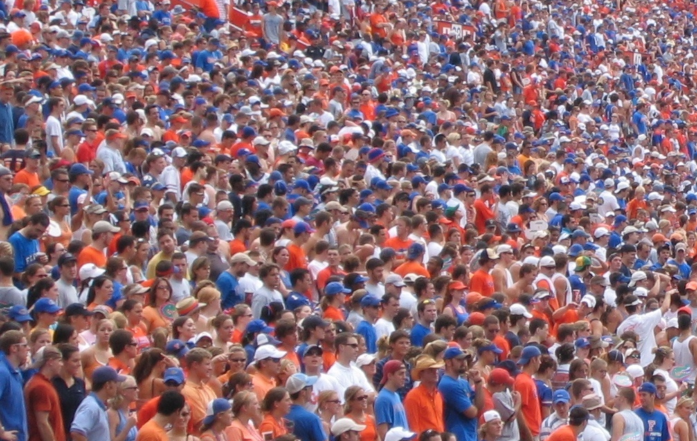
Discovery / Rendezvous
Over here, Alice!
Bob, where are you?

Slide 48
Bootstrapping – NATs
Node behind a NAT to a node on a public IP

Slide 49
Bootstrapping – NATs
Node behind a NAT to a node on a public IP

Slide 50
Bootstrapping – NATs
Node behind a NAT to a node on a public IP

Slide 51
Bootstrapping – NATs
Node behind a NAT to a node on a public IP

Slide 52
Bootstrapping – NATs
Node behind a NAT to a node on a public IP

Slide 53
Bootstrapping – NATs
Node behind a NAT to a node on a public IP
Failed NAT traversal

Slide 54
Bootstrapping – NATs
Node behind a NAT to a node on a public IP
Failed NAT traversal

Slide 55
Bootstrapping – NATs
Node behind a NAT to a node on a public IP
Failed NAT traversal

Slide 56
Bootstrapping – NATs
Node behind a NAT to a node on a public IP
Failed NAT traversal

Slide 57
Bootstrapping – NATs
Node behind a NAT to a node on a public IP
Failed NAT traversal
Successful NAT traversal

Slide 58
Bootstrapping – NATs
Node behind a NAT to a node on a public IP
Failed NAT traversal
Successful NAT traversal

Slide 59
Bootstrapping – NATs
Node behind a NAT to a node on a public IP
Failed NAT traversal
Successful NAT traversal

Slide 60
Bootstrapping – NATs
Node behind a NAT to a node on a public IP
Failed NAT traversal
Successful NAT traversal

Slide 61
Bootstrapping – Reflection to Relaying
Reflection (via STUN)

Slide 62
Bootstrapping – Reflection to Relaying
Reflection (via STUN)

Slide 63
Bootstrapping – Reflection to Relaying
Reflection (via STUN)

Slide 64
Bootstrapping – Reflection to Relaying
Reflection (via STUN)

Slide 65
Bootstrapping – Reflection to Relaying
Reflection (via STUN)

Slide 66
Bootstrapping – Reflection to Relaying
Reflection (via STUN)
NAT traversal initiated by a relay

Slide 67
Bootstrapping – Reflection to Relaying
Reflection (via STUN)
NAT traversal initiated by a relay

Slide 68
Bootstrapping – Reflection to Relaying
Reflection (via STUN)
NAT traversal initiated by a relay

Slide 69
Bootstrapping – Reflection to Relaying
Reflection (via STUN)
NAT traversal initiated by a relay

Slide 70
Supporting Recursion
NAT traversal always multiplexes a single UDP socket, thus for Cone NAT systems, the peer has a common public IP and port
Each overlay has a unique Path
Upon creating a link, an RPC from the creator to the receiver specifies which Path the link belongs
Requires that a single pathway can be multiplexed
  TCP does this by using different source ports
  UDP requires an additional header containing source and destination remote IDs (Something TCP will require too if NAT traversal is to be supported)

