Slide 1
OverSoc
Social Profile Based Overlays
David Wolinsky, Pierre St. Juste, Oscar Boykin, and Renato Figueiredo
ACIS P2P Group
University of Florida

Slide 2
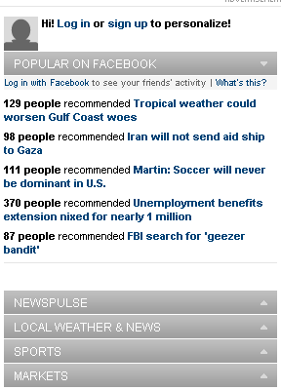
Issues
Social networking profiles are the ultimate means to make targeted advertisements
  Targets situations in your life: marriage and babies
  Follow you on the web
    Facebook’s beacon
    “Personalize” websites (example: CNN)
Access control is difficult
  OSNs favor open models, users must
  explicitly disable content or opt out
  OSNs, overtime, have made more
  private information public

Slide 3
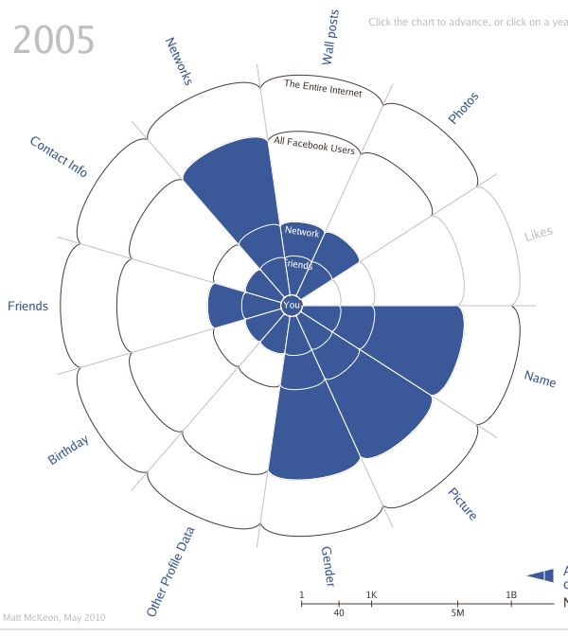
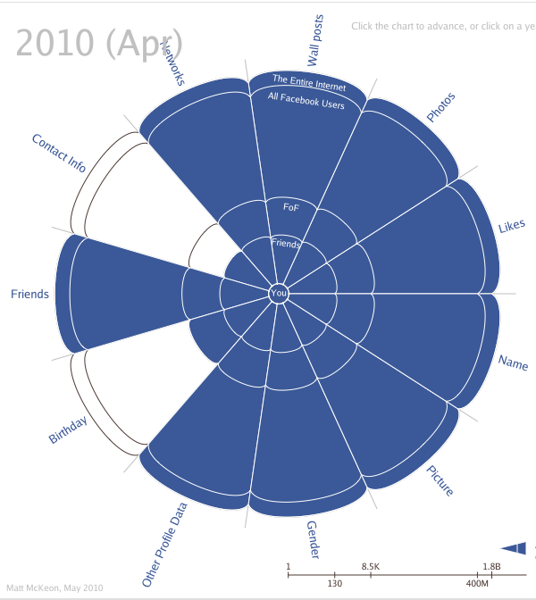
Privacy in Facebook

Slide 4
Motivation
Centralized services require capital to continue, motivating OSNs to be invasive
Users can choose something different, CNN could use FOAF (Friend of a Friend)
Many ways to organize a decentralized OSN, existing work:
  Requires a user to be online to be accessible
  Replicate entire profiles to many users
  Challenges in finding friends
Structured overlays can be leveraged for better data distribution and organization

Slide 5
Outline
Issues and Motivation
OverSoc Introduction
State of Structured Overlays
OverSoc Architecture
Remaining Challenges

Slide 6
Outline
Issues and Motivation
OverSoc Introduction
State of Structured Overlays
OverSoc Architecture
Remaining Challenges

Slide 7
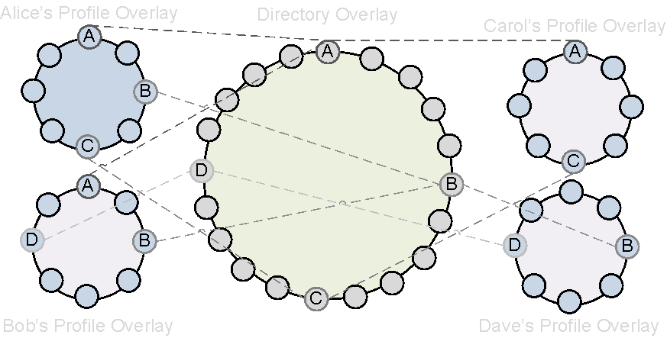
Introducing OverSoc
User-centric
  Each has their own overlay
  Content stored on self
  and peers
  Identity stored using PGP
  All links in profile overlay are secured, only authorized peers can access
Share a common directory overlay
  Used to find peers
  Used to connect to users’ overlays
Groups – shared user overlays

Slide 8
Outline
Issues and Motivation
OverSoc Introduction
State of Structured Overlays
OverSoc Architecture
Remaining Challenges

Slide 9
Structured Overlays
Efficient key/value lookup through DHT
  O(log N) look up time
  Results from eDonkey KAD studies show that DHT data in P2P media sharing applications has high consistency [1]
    Store on peers that have been online for more than 2 hours
    Replicate sufficiently (10 times)
Real world usage
  eDonkey KAD finds media via hashes / keywords
  Torrentless BitTorrent Tracker
  LimeWire to assist in firewall / NAT traversal (push proxies)

Slide 10
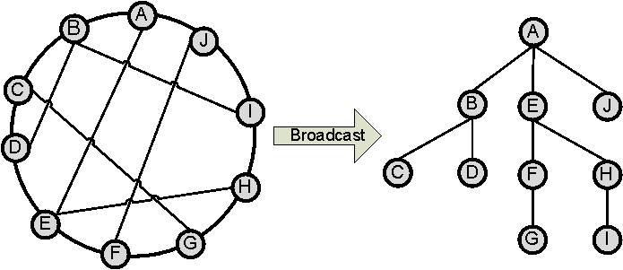
Structured Overlays
Efficient broadcasting
  Log^2(n), no overlap
  Distribute / aggregate [2]
    First broadcast
    Once complete, results are reduced and returned to broadcast sender
  DeeToo [3]
    Broadcasting can efficiently find things, but efficient distribution is still challenging
    Use two rings, one transposes the other, one used for storing the other for searching
    Broadcasts store, Distribute/aggregate searches

Slide 11
Our Related Work
Our foray into OSNs thus far has focused on Social IP connectivity and bootstrapping private overlays
SocialVPN[4]
  Leverage existing social networks to create IP links
  Reuse existing network applications
  Each peer has their own VPN address space, no IP collisions

Slide 12
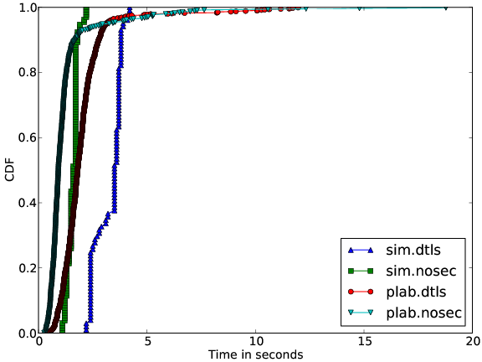
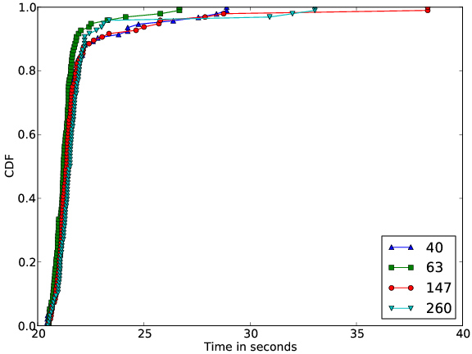
Our Related Work
Creating private overlays
  DTLS secures all P2P links
  Certificates given out by a CA
  Bootstrapped from a public overlay
Add a node to an existing overlay
Bootstrap from a public overlay
into a private overlay

Slide 13
Outline
Issues and Motivation
OverSoc Introduction
State of Structured Overlays
OverSoc Architecture
Remaining Challenges

Slide 14
Identity in the Directory Overlay
Peers are identified by their PGP certificate
Key features of PGP:
  Friends are identified by signing each others certificate, a list of friend of friends
  Embed text data such as full name, e-mail address, and other data
PGP has a weak revocation model
  Each friend signature should have a TTL
  Friends renew signatures, keep friendship active
  Inactive friendships become apparent

Slide 15
Finding Friends
Peers can use DeeToo to distribute and find their PGP certificates
PGP certificates contain:
  Any information peers want public
  P2P Address in the directory overlay to use as a mailbox for friendship requests
Third party services can store the certificate and friendships can be established out of band
Peers seeking extreme privacy, need not store anything inside the Directory overlay

Slide 16
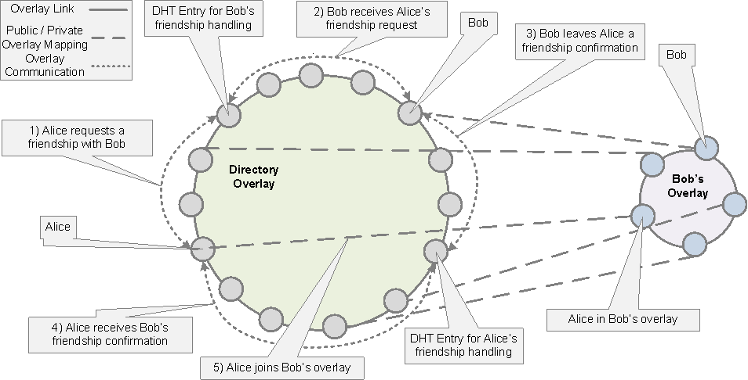
Establishing a Friendship
Alice has found Bob’s certificate and now is establishing a friendship

Slide 17
Defriending
Occurs if a peer does not renew a PGP signature prior to the timeout expiring
Broadcast revocation
Store revocation in the profile DHT

Slide 18
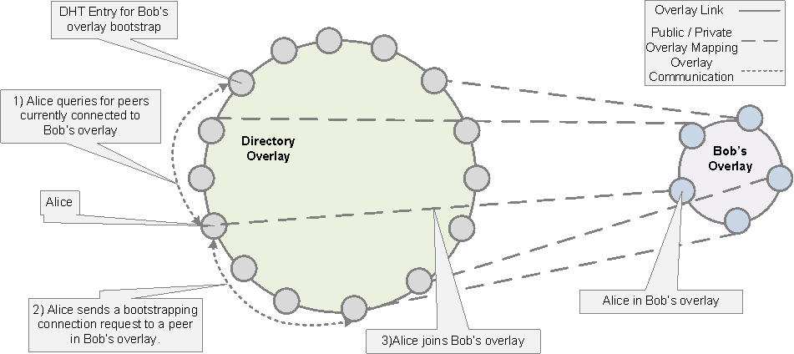
Connecting to a Profile Overlay
Alice and Bob have a relationship, Alice wants to connect to Bob’s overlay

Slide 19
Private Messages
Two types:
  Friendship requests in the directory
  Private messages in the profile overlay
Private message format:
  Encrypt(secret, msg, hash(msg)) + Encrypt(public_key, secret)
Only peer with the private key can read message
Msg contains information such as the sender, receiver, and time of transmission

Slide 20
Operations inside the Profile Overlay
Private messages
  Store private messages in an explicit key space
  Process is unidirectional
    Private message from Alice to Bob is stored in Bob’s overlay
    Private message to Bob from Alice is stored in Alice’s overlay
Public messages are unencrypted but are signed to prevent unidentifiable messages
Owner can insert a public message removal

Slide 21
Outline
Issues and Motivation
OverSoc Introduction
State of Structured Overlays
OverSoc Architecture
Remaining Challenges

Slide 22
Remaining Challenges
Handling Small Overlay Networks
  Most P2P research has been performed on scalability and reliability of large ( > 1,000) peers
  Users on Facebook average only 130 friends
  How to efficiently leverage small structured overlays
Overlay support for low throughput, unconnected devices
  Passive nodes – common to many DHTs
  Ability to modify and update users profile

Slide 23
Remaining Challenges
Preventing flood attacks in public overlays
  Published decentralized security techniques
  Work done by KAD used in P2P sharing apps
Data storage
  No need to reimplement data stores for messages
  Examples of previous work: Past / Kosha

Slide 24
Related Work
The techniques in OverSoc could be used to enhance existing projects:
PeerSon places all parties into a common DHT
Vis-à-Vis stores all data on the user’s node
SafeBook relies on a central database to coordinate friendships
Challenges to getting users bootstrapped…. Maybe Diaspora will be successful

Slide 25
Conclusion
OverSoc techniques leverage existing structured overlay techniques to construct profile based overlays
Future directions:
  Investigate existing decentralized OSNs and integrate OverSoc concepts into them
  Address “Remaining Challenges”

Slide 26
New References
M. Steiner, T. En-Najjary , and E.W. Biersack. “A Global View of KAD.” IMC’07
J. Li, K. Sollins, and D. Lim. “Implementing Aggregation and Broadcast over Distributed Hash Tables.” SIGCOMM Comput. Commun. Rev. 2005
T. Choi and O. Boykin. DeeToo: Scalable “Unstructured Search Built on a Structured Overlay.” HOTP2P’10
P. St. Juste, D. Wolinsky. O. Boykin, M. Covington, and R. Figueiredo. “SocialVPN: Enabling wide-area collaboration with integrated social and overlay networks.” Journal of Computer Networks. 01/2010

Slide 27
Thank you!
Questions?

